Slide 1
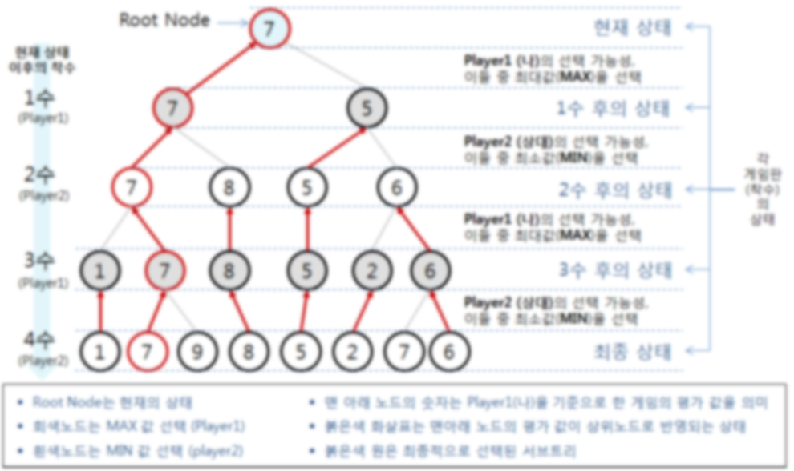
Monte-Carlo Tree Search

Slide 2

MINIMAX

Slide 3
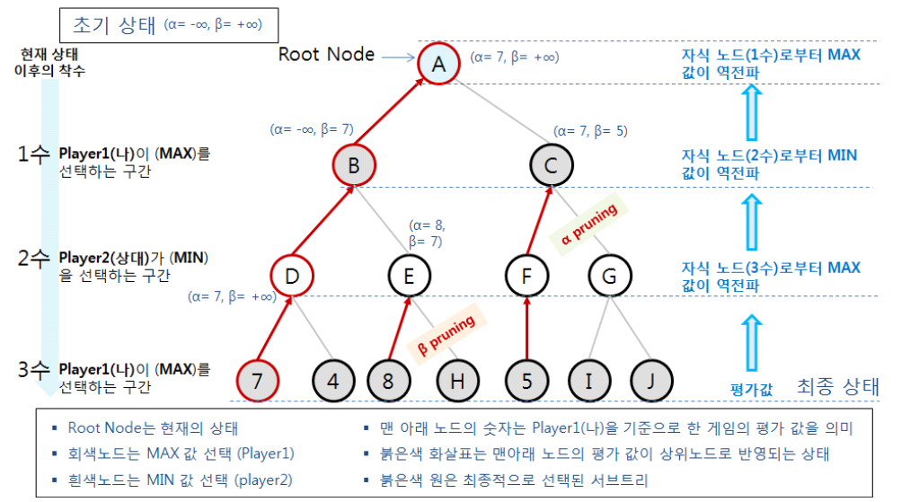
Alpha-Beta Pruning

Slide 4



Upper Confidence Bound (UCB)
In Multi-armed bandit problem,
To maximize expected reward
$$i=argmaxi μi+Pi$$
t = 현재 시간,
n_{i} = i 번째 arm이 선택된 횟수
MCTS에서, Tree policy로 사용

Slide 5
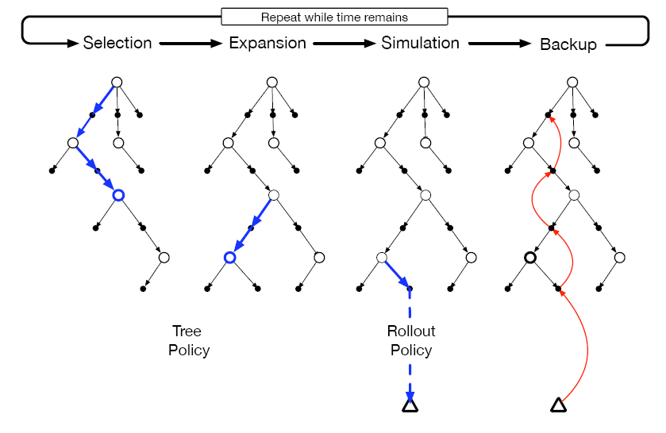
Monte-Carlo Tree Search (MCTS)
Selection. root노드로 부터, edge에 저장된 q값을 참조하는 ‘Tree policy’를 따라 leaf노드까지 도달.
Expansion. 선택 된 leaf노드에서 특정 기준에 따라 가본적 없는 child노드로 방문 (트리 확장)
Simulation. 선택 된 leaf노드 혹은 새로운 child노드에서 , ‘rollout policy’를 따라 episode를 완성
Backup. Simulated episode에서 return을 얻은 뒤, 해당 episode내에서 tree policy에 의해 방문 된 노드들에만 값을 update. (rollout으로 간 첫 a에 대해서는 초기값으로 만들어 줌)

Slide 6
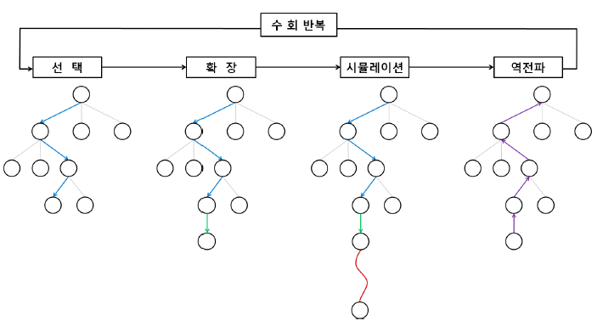
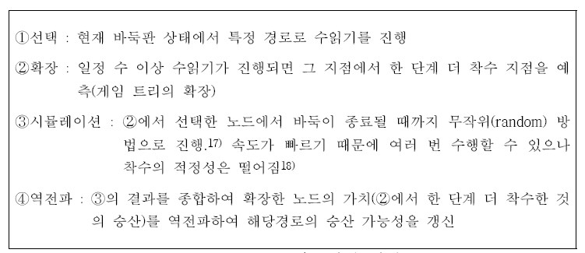
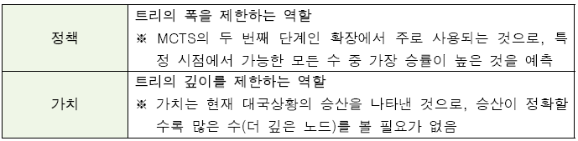
MCTS in AlphaGo

Slide 7
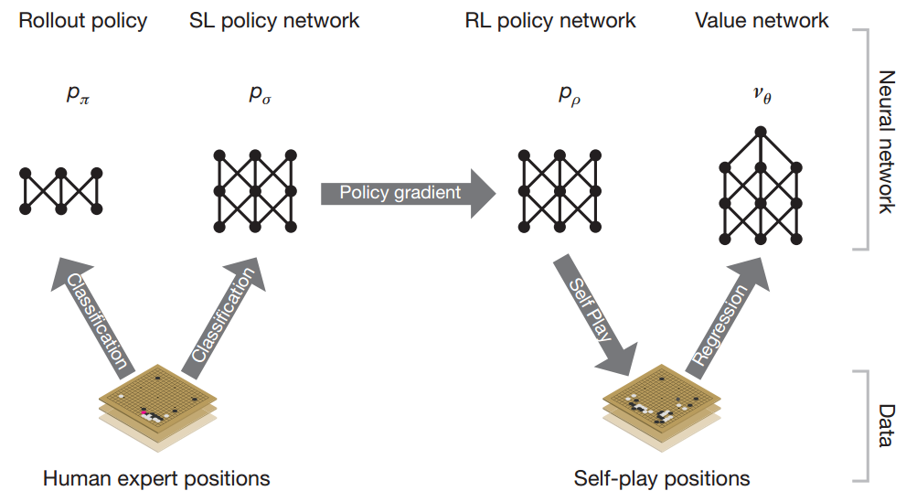
AlphaGo

Slide 8
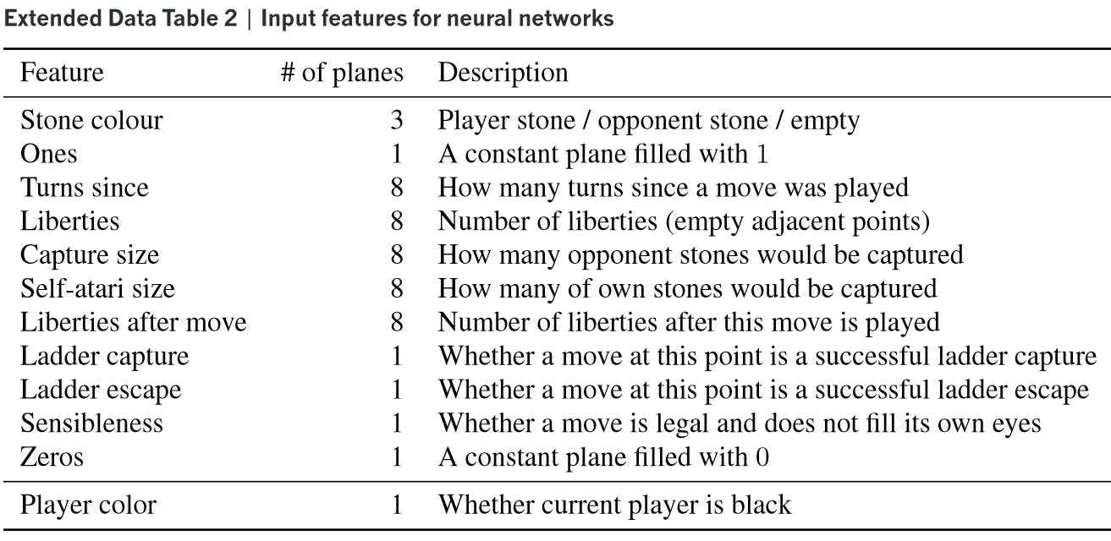
AlphaGo
Input features for CNN

Slide 9
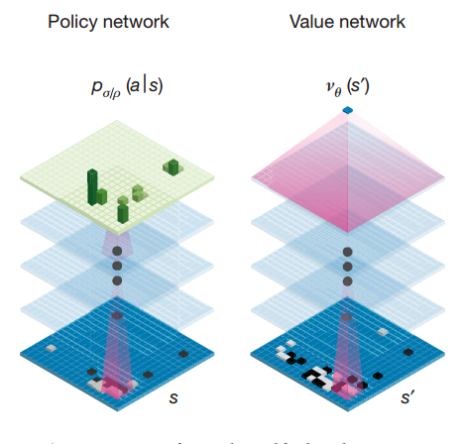

AlphaGo
Supervised Learning of Policy Network
Rollout policy
SL policy network
Trained to predict human expert moves.
Dataset: 30 million positions from KGS Go Server.
To maximize the likelihood of the human move a selected in s .
Rollout –- acc: 24.2 %, runtime: 2 μs.
SL Net -- acc: 57.0 %, runtime: 3 ms.
$$∆σ∝\frac{∂\log{Pσ(a|s)}}{∂σ}$$

Slide 10

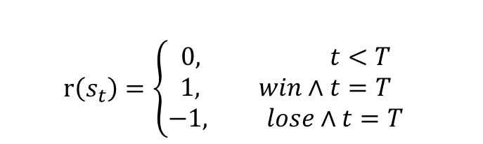
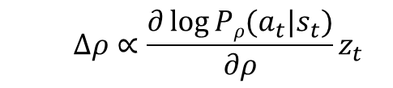
AlphaGo
Reinforcement Learning of Policy Network
Initialized to SL Net.
Self play game between current policy and randomly selected previous one.
Reward:
Outcome:
Maximize
RL policy network won >80% against SL Net.
$$r\left(s_{t}\right)=\left\{\begin{aligned}0, t<T \\ 1, win∧t=T \\ &−1, lose∧t=T\end{aligned}\right.$$
$$z_{t}=r(s_{T})$$
$$∆ρ∝\frac{∂\log{Pρ(a_{t}|s_{t})}}{∂ρ}z_{t}$$

Slide 11

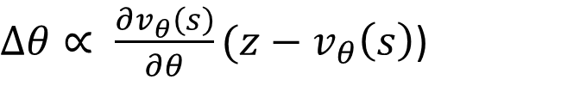

AlphaGo
Reinforcement Learning of Value Network
Predict the outcome from position s played by using policy p for both players.
Optimal value $v^{∗}(s)$ 를 알 수 없기 때문에, RL Net으$로 v^{p_{ρ}}$ 추정. Approximate the value function using $v_{θ}(s)$
즉, $v_{θ}(s)≈v^{p_{ρ}}(s)≈v^{∗}(s)$.
Minimize MSE between predicted value $v_{θ}(s)$ and corresponding outcome z.
Test MSE: 0.234
$$v^{p}\left(s\right)=𝔼[z_{t}|s_{t}=s, a_{t…T}\sim p]$$
$∆θ∝ \frac{∂v_{θ}\left(s\right)}{∂θ}(z−v_{θ}\left(s\right)$)

Slide 12
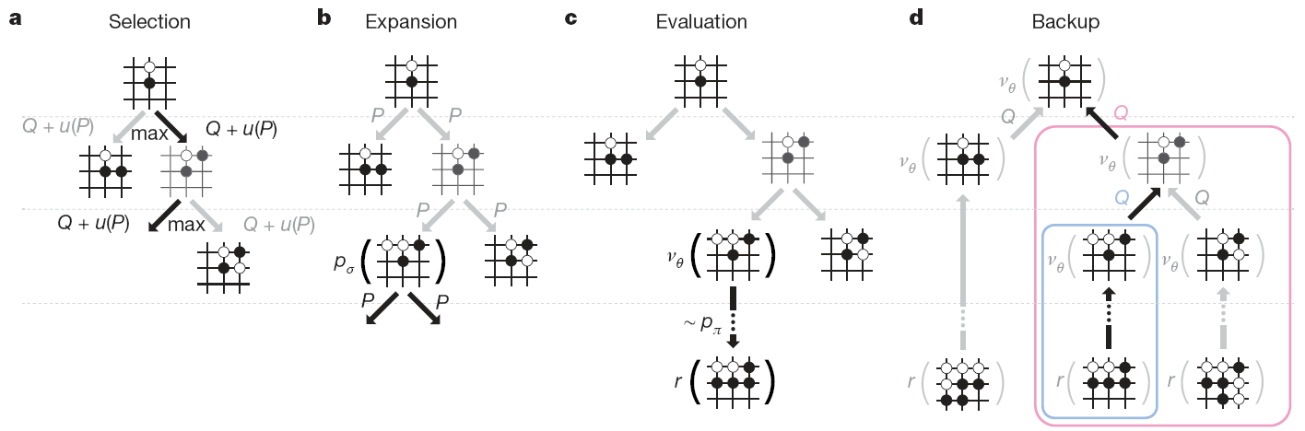

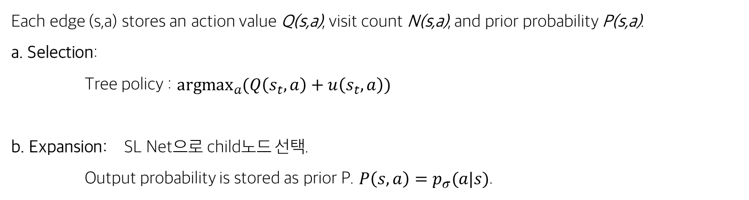
AlphaGo
Searching with Policy and Value Networks
Each edge (s,a) stores an action value Q(s,a), visit count N(s,a), and prior probability P(s,a).
a. Selection:
Tree policy : $\underset{a}{argmax}{(Q\left(s_{t},a\right)+u\left(s_{t},a\right))}$
b. Expansion: SL Net으로 child노드 선택.
Output probability is stored as prior P. $P\left(s,a\right)=p_{σ}(a|s)$.
bonus: $u\left(s,a\right)∝\frac{P(s,a)}{1+N(s,a)}$

Slide 13
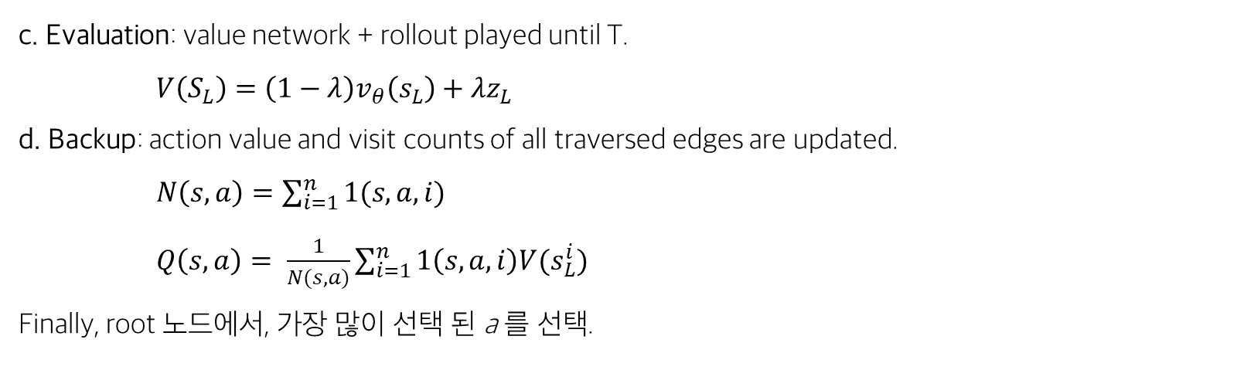
AlphaGo
Searching with Policy and Value Networks
c. Evaluation: value network + rollout played until T.
$V\left(S_{L}\right)=\left(1−λ\right)v_{θ}\left(s_{L}\right)+λz_{L}$
d. Backup: action value and visit counts of all traversed edges are updated.
$N\left(s,a\right)=\sum_{i=1}^{n}{1(s,a,i)}$
$Q\left(s,a\right)= \frac{1}{N(s,a)}\sum_{i=1}^{n}{1\left(s,a,i\right)V(s_{L}^{i})}$
Finally, root 노드에서, 가장 많이 선택 된 a 를 선택.

Slide 14
AlphaGo Zero
Comparison to AlphaGo
Trained solely by self-play RL, starting from random play.
Using only black and white stones as input features.
Single network.
Simple tree search (without rollout).

Slide 15

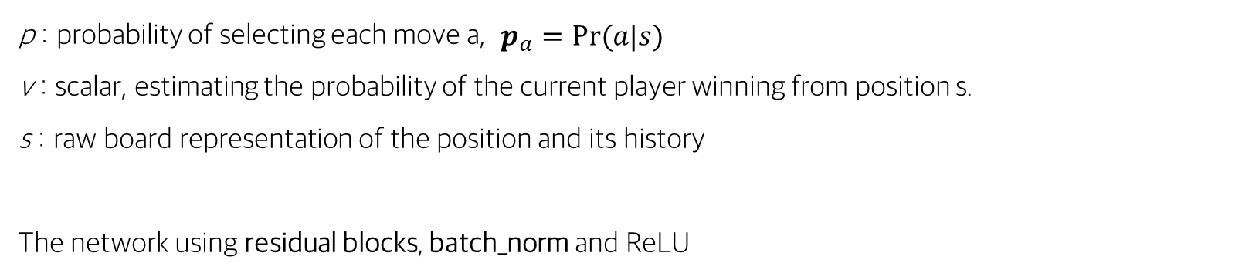
AlphaGo Zero
RL in AlphaGo Zero
$$\left(p, v\right)= f_{θ}(s)$$
p : probability of selecting each move a, $p_{a}=Pr⁡(a|s)$
v : scalar, estimating the probability of the current player winning from position s.
s : raw board representation of the position and its history
The network using residual blocks, batch_norm and ReLU

Slide 16
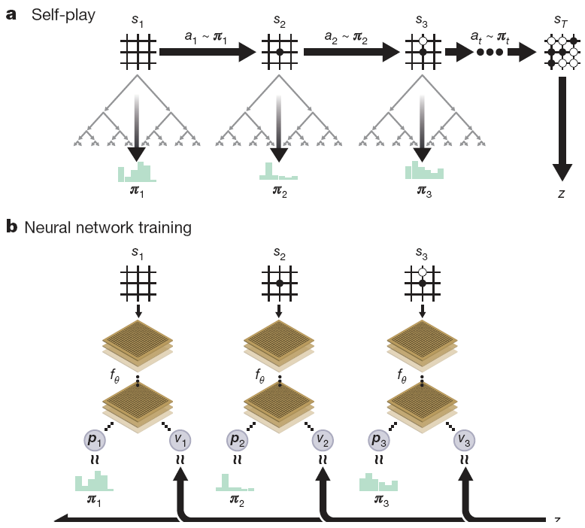
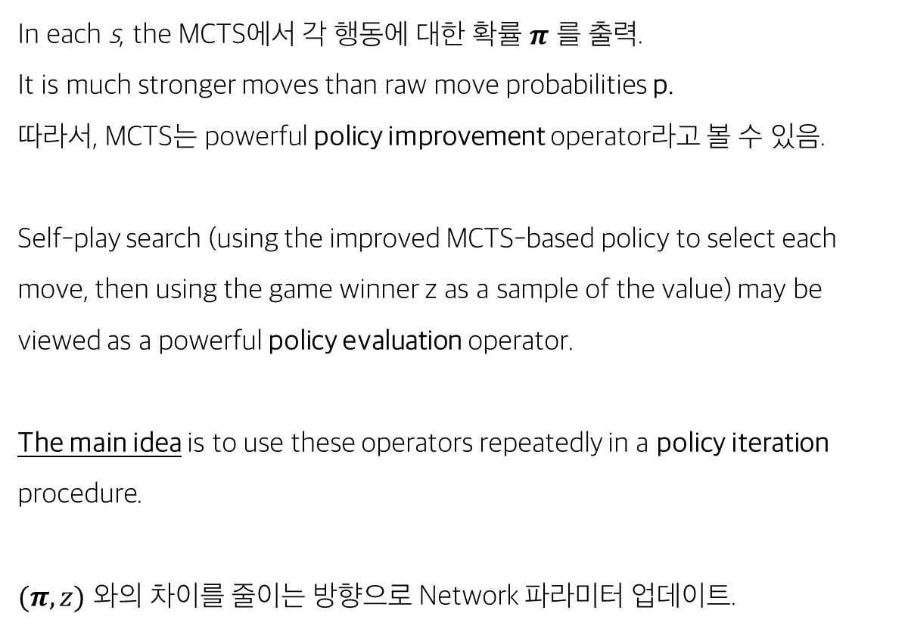
AlphaGo Zero
MCTS
In each s, the MCTS에서 각 행동에 대한 확률 $π$ 를 출력.
It is much stronger moves than raw move probabilities p.
따라서, MCTS는 powerful policy improvement operator라고 볼 수 있음.
Self-play search (using the improved MCTS-based policy to select each move, then using the game winner z as a sample of the value) may be viewed as a powerful policy evaluation operator.
The main idea is to use these operators repeatedly in a policy iteration procedure.
$(π, z)$ 와의 차이를 줄이는 방향으로 Network 파라미터 업데이트.

Slide 17
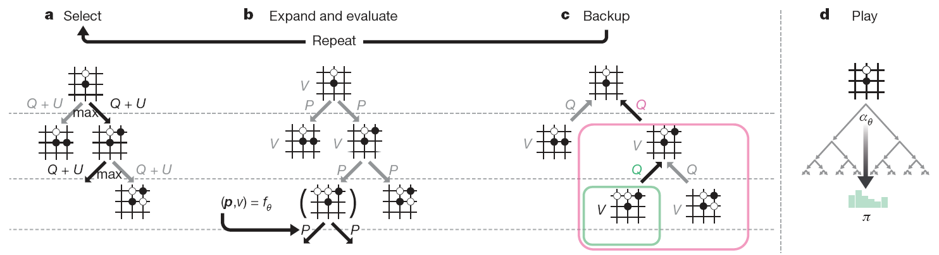
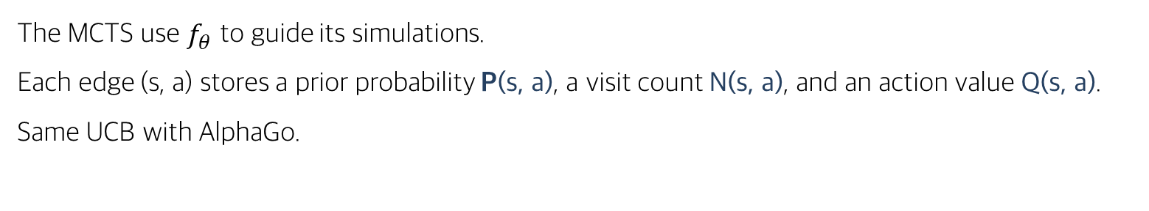
AlphaGo Zero
MCTS
The MCTS use $f_{θ}$ to guide its simulations.
Each edge (s, a) stores a prior probability P(s, a), a visit count N(s, a), and an action value Q(s, a).
Same UCB with AlphaGo.

Slide 18
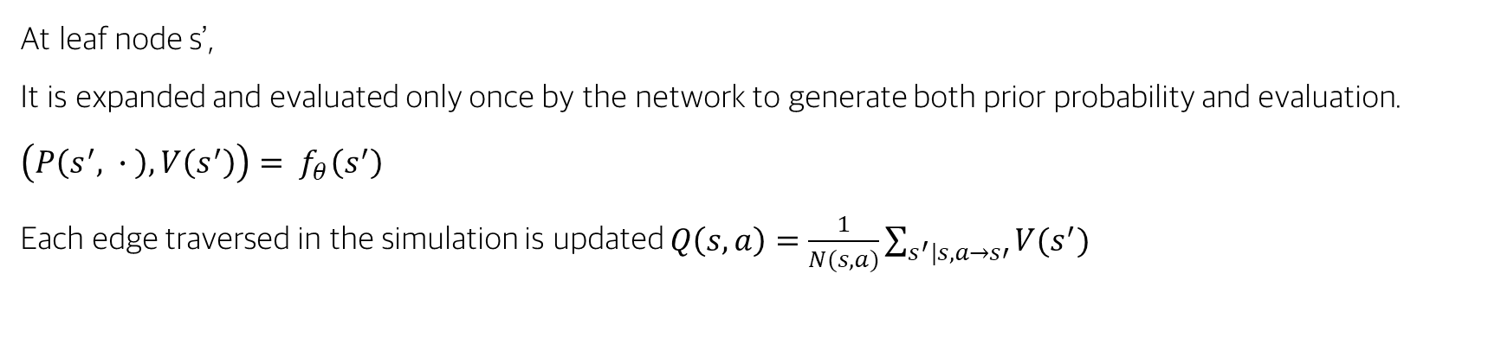
AlphaGo Zero
MCTS
At leaf node s’,
It is expanded and evaluated only once by the network to generate both prior probability and evaluation.
$\left(P\left(s^{′}, ∙ \right), V\left(s^{′}\right)\right)= f_{θ}\left(s^{′}\right)$
Each edge traversed in the simulation is updated $Q\left(s,a\right)=\frac{1}{N(s, a)}\sum_{s^{′}|s,a→s′}{V(s^{′})}$

Slide 19
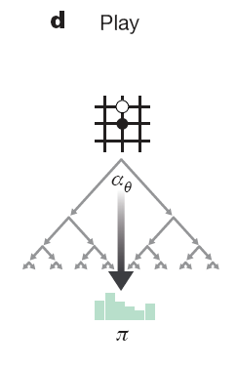
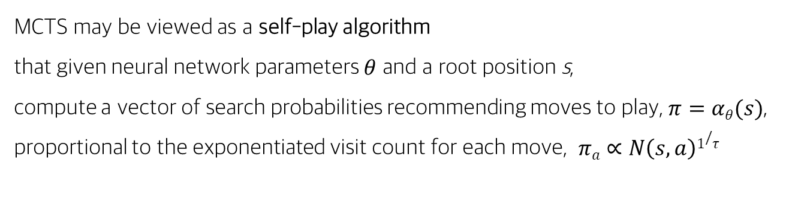
AlphaGo Zero
MCTS
MCTS may be viewed as a self-play algorithm that given neural network parameters $θ$ and a root position s, compute a vector of search probabilities recommending moves to play, $π=αθ(s)$, proportional to the exponentiated visit count for each move, $πa∝N\left(s,a\right)1/τ$

Slide 20
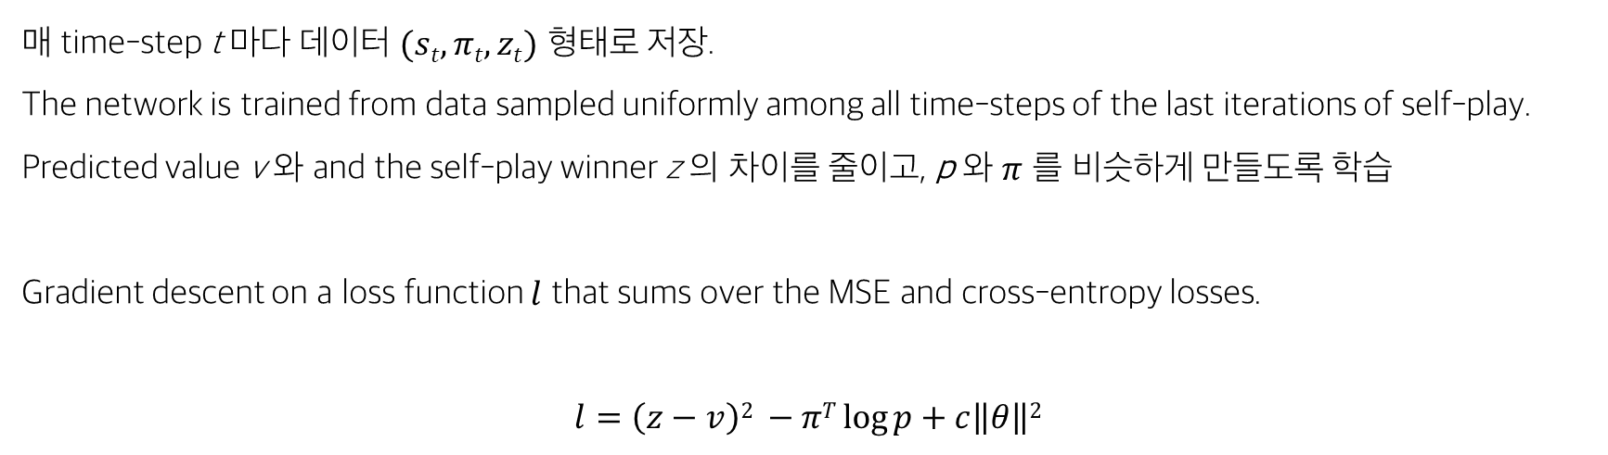
AlphaGo Zero
MCTS
매 time-step t 마다 데이터 $(st, πt, zt)$ 형태로 저장.
The network is trained from data sampled uniformly among all time-steps of the last iterations of self-play.
Predicted value v 와 and the self-play winner z 의 차이를 줄이고, p 와 $π$ 를 비슷하게 만들도록 학습
Gradient descent on a loss function $l$ that sums over the MSE and cross-entropy losses.
$$l=\left(z−v\right)2 −πT\log{p}+c\left\|θ\right\|2$$

